Slide 1
Traditional folk dances in Croatia
Mislav Muheljić

Slide 2
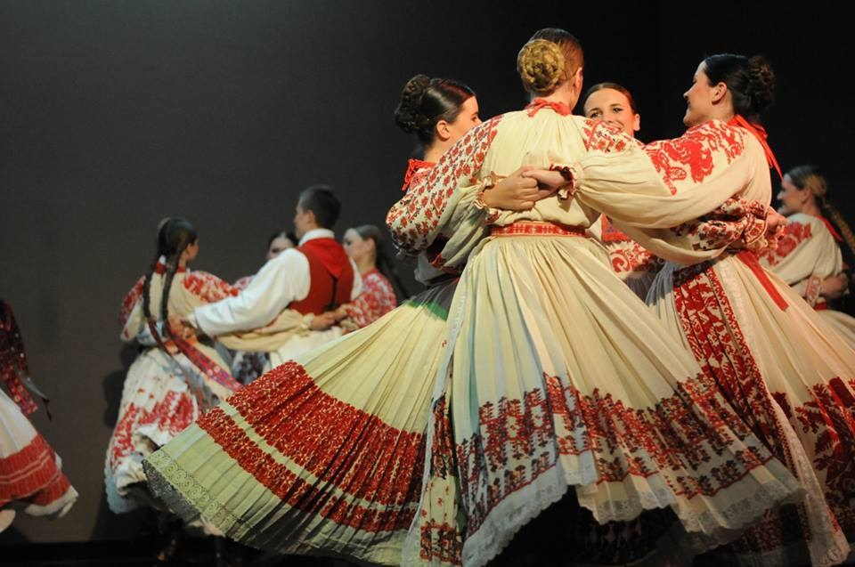
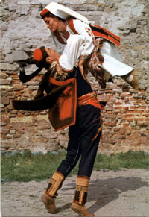
rich cultural heritage can be seen in Croatian music
Striking diversities which developed in folk music of the country can be explained by the Mediterranean, Balkan, and Central European influences Croatia was exposed to
Each region has its own – unique dance
throughout the country - quite a few types of folk dances
Croatian dance tradition was also determined by the convergence of different cultures of specific regions.

Slide 3
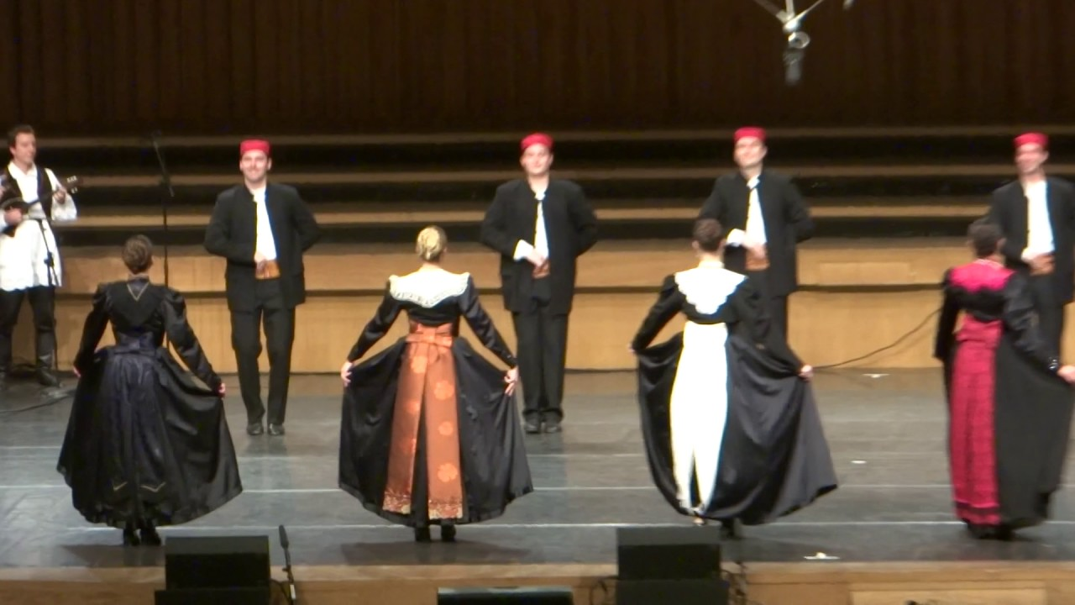
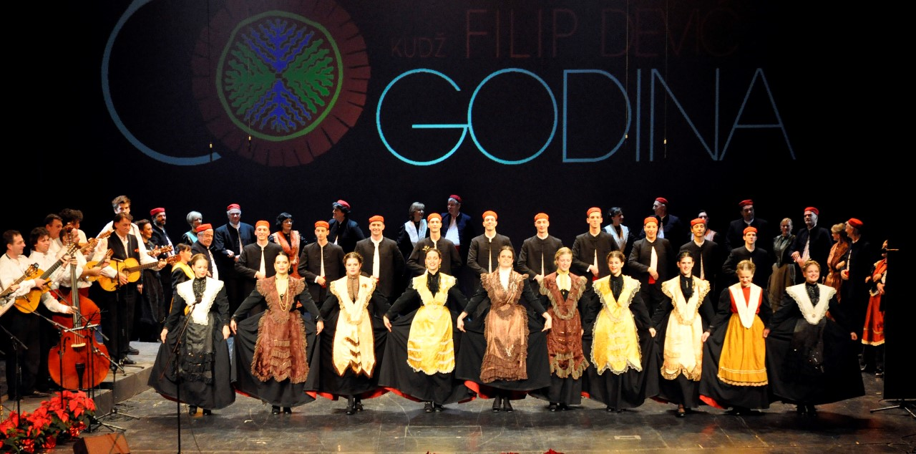
Split traditional dance
Split traditional dances are characterized by noble bearing, distinguishing style and refine movements, all connected with a typical Dalmatian “fjaka” (similar to leisure time of not doing anything or doing things in a rather slow manner, tiredish like).
Folk costumes attract the attention with their gorgeous ravishing look. Traditional Split dances are performed in festive Split costume that gained its final from in the second half of the 19th century. Man’s costume emerged from the Dinara type, while female costume belongs to the Adriatic type.

Slide 4
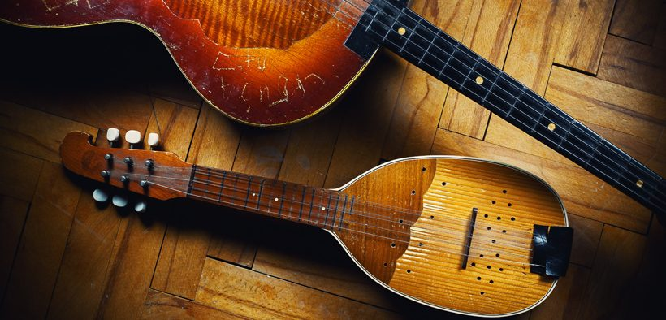
Music is a very important part of Croatian folk dance, with of the most common instruments used are the tamburica, lijerica, jedinka, šargija, gusle, bagpipe, and accordion.

Slide 5
Traditional kolo
The traditional Croatian dance is usually associated with kolo
a simple circular form of dance, where dancers follow each other around the circle, which shows a need for community expression.
used to be not just a dance form, but also a social gathering, at which people could get to know each other
is relatively simple in form
today, kolo is danced at weddings, baptisms, holidays such as Easter, and ethnic festivals.

Slide 6
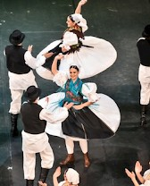
LADO - National Folk Dance Ensemble of Croatia
38 professional performers
Performers that both dance and sing at the highest artistic level
14 virtuoso musicians
Musicians who play a total of 80 different traditional instruments
LADO is a "2 in 1": dance company as well as a top choir
Every LADO artist is both a dancer and a singer, which allows versatility. Performances can be dance performances, singing performances and both elements together, all accompanied by the orchestra

Slide 7
